Slide 1
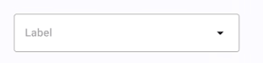
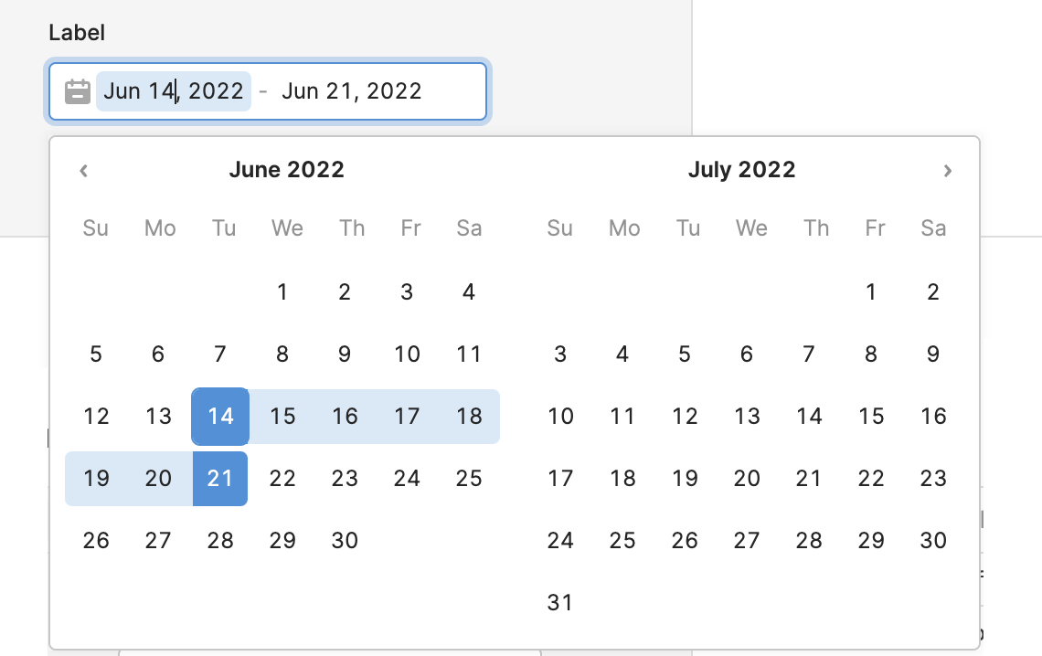
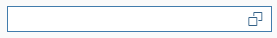
What’s On? Find you next watch
Filters
Genre
Release Year
Movie titles
Actors
Producer
Recommendations
Movie name | Genre | Release Year | Actors | Producers | Description

